Slide 1
Predictive Maintenance of Aircraft Engines Using Machine Learning
A Data-Driven Approach to Estimating Remaining Useful Life (RUL)

Slide 2
Estimating Remaining Useful Life with NASA Turbofan Data 15/04/2025
Team members:
Fatma Al-Zahraa Hassan Abdullah
Karim Hamed Ashour
Omayma Ali Abdelhafeez
Rana Ahmed Abu Gharib
Reham Ashraf Mohammed

Slide 3
Agenda
Introduction 2. Problem Formulation 3. Literature Review 4. Proposed Solution
5. Dataset • NASA Turbofan FD001 • Sensor data & RUL formulation
6. Methodology • Preprocessing & feature engineering • Model selection & evaluation
7. Tools & Technologies 8. Results & Evaluation 9. Conclusion & Future Work 10. Q&A

Slide 4
Project Overview:
Goal: Predict Remaining Useful Life (RUL) of aircraft engines to enable Predictive Maintenance
Approach: Machine learning applied to NASA Turbofan Jet Engine Dataset
Outcome: Web-based tool for real-time RUL prediction using Streamlit

Slide 5
Project Objectives
Develop an accurate RUL prediction model
Apply time-series feature engineering
Evaluate and optimize ML models
Deploy as interactive web app
Enhance safety and reduce maintenance cost

Slide 6
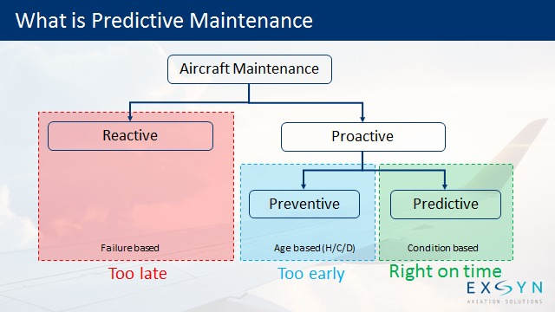
Why Predictive Maintenance Matters
Traditional maintenance: reactive or fixed schedule
Predictive Maintenance: data-driven, timely, and cost-effective
Importance in aviation: safety, reliability, efficiency

Slide 7
Key Challenges
Complex time-series data
Variable degradation patterns
Noise in sensor readings
Need for real-time predictions

Slide 8
Literature Review Summary
Overview of existing PdM systems
Commonly used models: LSTM, RF, XGBoost
Gaps: Limited scalability, generalization, or interpretability

Slide 9
Our Proposed AI Approach
Focused on multivariate sensor data
Applied models: RF, XGBoost, LightGBM
Emphasis on feature engineering & model performance
Real-time user interface for deployment

Slide 10
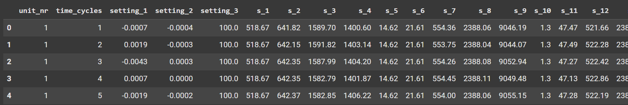
NASA FD001 Dataset
100 engines (train), 100 engines (test) 21 sensors 1 operating condition 1 fault mode: HPC degradation

Slide 11
Preprocessing & Feature Engineering
RUL computed from max cycle
Moving average, ROC, rolling window
Clipped RUL at 125 to improve learning
MinMaxScaler applied to numeric features

Slide 12
ML Workflow Overview
Data loading
Feature selection & engineering
Train-test split
Model training & tuning
Evaluation & Deployment

Slide 13
Feature Selection
Correlation heatmap used
Removed constant/irrelevant features
Final features selected from 21 sensors

Slide 14
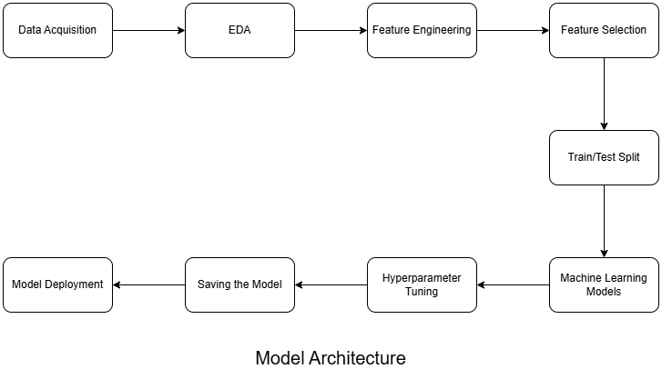
Development Stack
Languages: Python
Libraries: Pandas, NumPy, Scikit-learn, XGBoost, LightGBM
Platform: Streamlit for deployment
Libraries: Matplotlib, Seaborn for EDA

Slide 15
Model Performance
Evaluation metrics: MAE, MSE, R²
Models evaluated:
Random Forest
XGBoost (Best performance)(accuracy=0.78)
LightGBM
Performance improved after RUL clipping (>125)

Slide 16
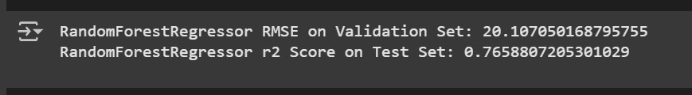
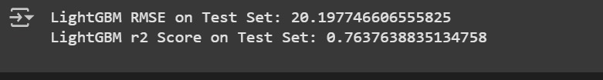

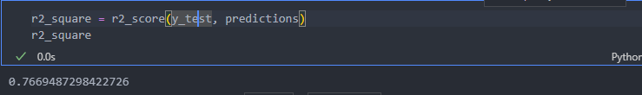
Model Performance:
Before:
After:

Slide 17
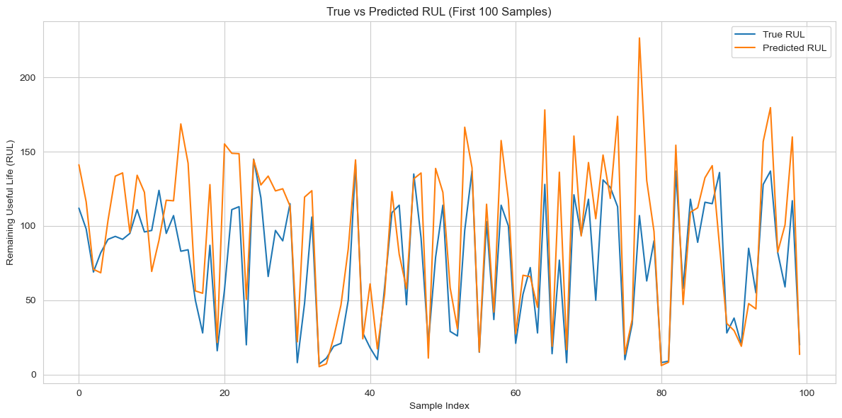
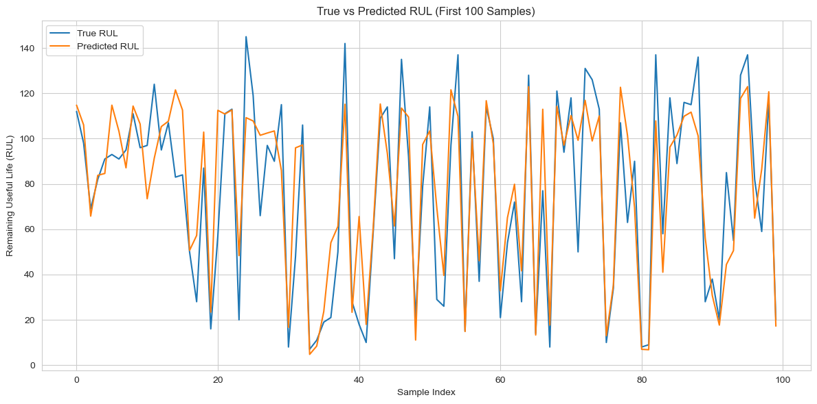
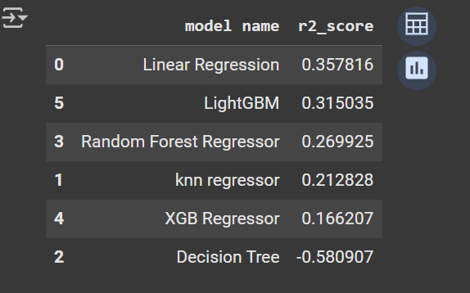
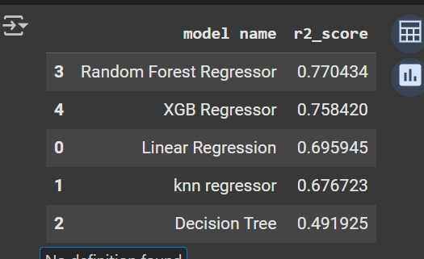
Before:
After:

Slide 18
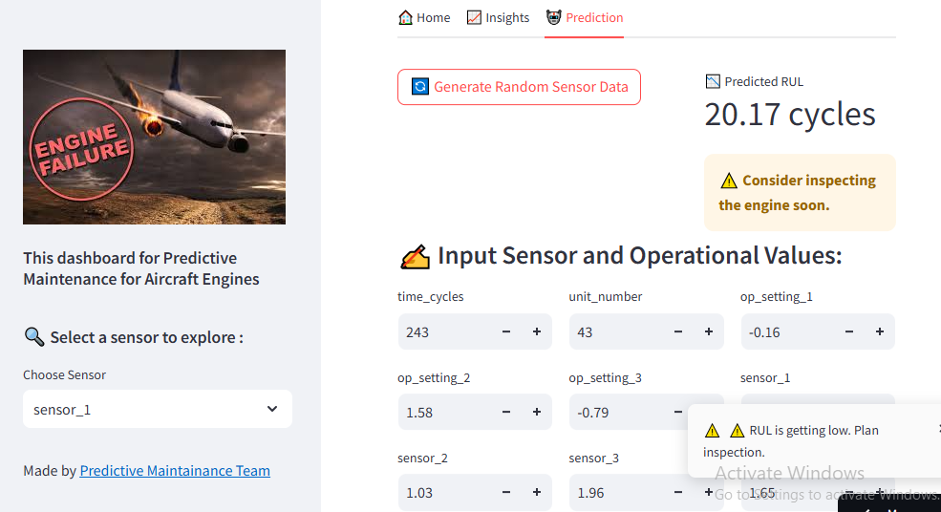
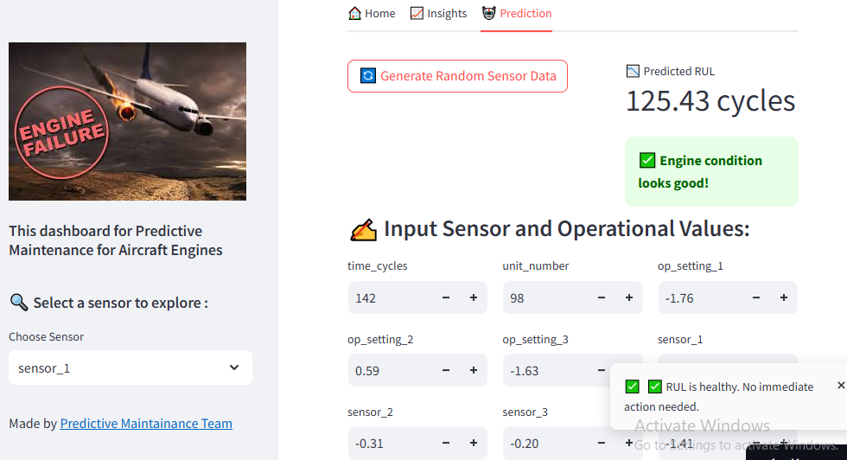
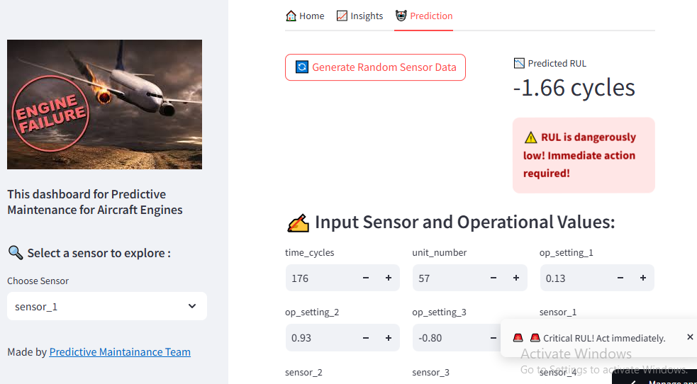
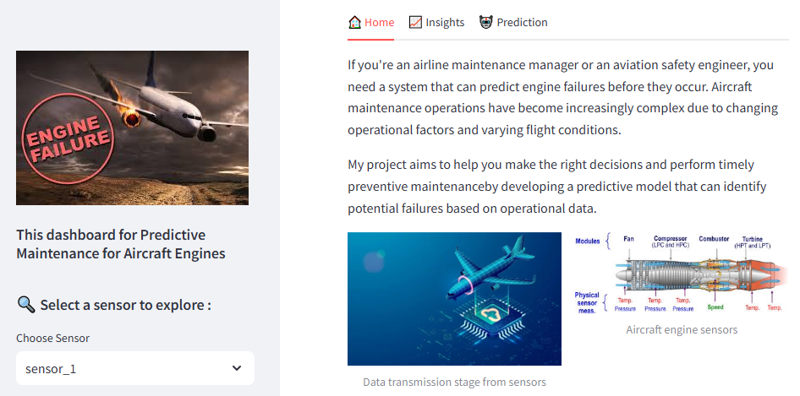
Prediction Visualization

Slide 19
Summary
Accurate RUL predictions are possible using ML Feature engineering and RUL clipping enhanced performance
Interactive tool helps industry adopt Predictive Maintenance.

Slide 20
Future Work
Test across different fault modes
Deploy on cloud for broader accessibility
Explore deep learning models (e.g., LSTM)

Slide 21
Any Questions?

Slide 22
Thank you

